Slide 1
Medicare Advantage 101: A Primer
April 17, 2019
Congressional Briefing

Slide 2
Today’s Agenda
12:10 - 12:20 Introduction & Opening Remarks
12:20 – 12:55 Medicare Advantage 101: A Primer
12:55 – 1:25 Panel: What’s Working in Medicare Advantage
1:25 – 1:30 Closing Remarks

Slide 3
What is Medicare Advantage?

Slide 4



Overview of Medicare Advantage
Medicare Advantage is the managed care alternative to fee-for-service (FFS) Medicare.
Traditional FFS Medicare
Provides access to Parts A and B covered services May see any provider who accepts Medicare, no network restrictions Beneficiary pays 20% coinsurance for covered services Medigap policies are available to reduce beneficiary out-of-pocket costs No out-of-pocket limit
Government Administers
Benefit
Medicare Beneficiary
Medicare Advantage Plan
Provides access to Parts A and B covered services, may include additional supplemental benefits Plans may not provide identical access to providers in FFS Medicare Cost sharing may be above or below FFS Medicare, but must be actuarily equivalent Annual out-of-pocket limit
Private Insurer Administers
Benefit
Government Contracts with Private Insurer
Government Pays
Private Insurer

Slide 5



Overview of Medicare Advantage
Medicare Advantage covers medical care and prescription drugs, and often offers extra benefits and lower out-of-pocket costs compared to FFS Medicare.
 |  | Coverage | Monthly Premium | Cost Sharing
FFS |  | Hospital services | Typically $0, or up to $437 | Deductible: $1,364/year Copay/Coinsurance: Varies
 |  | Physician services, physician-administered medications | Typically $135.50, or more for higher income enrollees | Deductible: $185/year Coinsurance: Typically 20%
Part D |  | Medications from a pharmacy | $33.19/month base premium | Deductible: Limited to $415 Coinsurance: 25% for up to $3,820 in total drug costs before donut hole
MA |  | Hospital services, physician services, medications from a pharmacy, and other supplemental benefits | $28.00/month on average | Total Cost Sharing: Limited to $6,700/year (CMS recommends $3,400/year)
Part A
Part B
Part D
Part C

Slide 6
Medicare Advantage Plan Types
Individual Plans
MA offers several individual plan options that have various types of access to provider networks, including health maintenance organizations (HMOs) – the most popular choice among MA beneficiaries
Employer Plans | Special Needs Plans (SNPs)
Some employers provide coverage to retirees through an MA option called an employer group waiver plan (EGWP) | SNPs enroll beneficiaries who are dual-eligible, need institutionalized care, or have specific chronic diseases
Long-Term

Slide 7
Who Enrolls in Medicare Advantage?

Slide 8
Medicare Advantage Enrollment
MA AS % OF TOTAL MEDICARE ENROLLMENT
8
CBO: Congressional Budget Office; MA: Medicare Advantage
Source: Medicare Baseline Estimates. Congressional Budget Office. January 2017. Available here.

Slide 9
Medicare Advantage Enrollment Demographics
Demographic Differences between MA and FFS Medicare:
Age: MA and FFS are similar in age (71.6 and 70.5, respectively)
Gender: A higher proportion of MA enrollees are female (56.3% vs 53%)
Race: White and Asian less likely to enroll in MA; Black more likely to enroll in MA; Hispanic much more likely to enroll in MA
Income: A greater share of the MA population has income below 200% of the federal poverty level (~$32,000/year for a couple)
Education: A greater share of the MA population has received less than a high school education, and a greater share of the FFS population has completed college
9
Source: Draft analysis by Anne Tumlinson Innovations of data from the Medicare Current Beneficiary Survey (MCBS) for 2016 .

Slide 10
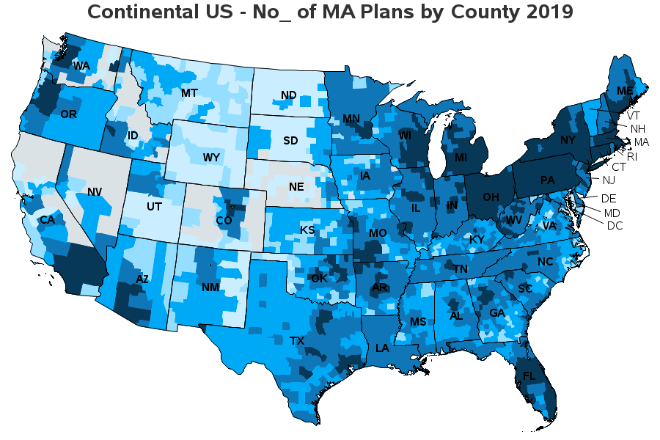


Availability of Medicare Advantage
Availability of Medicare Advantage plans tends to be concentrated in certain regions and in large metro areas, though 99%+ of seniors have access to at least 1 plan.
NUMBER OF Medicare Advantage PLANS BY COUNTY, 2019
At least 20 (558 counties)
10 to 19 (1,184 counties)
5 to 9 (821 counties)
3 to 4 (222 counties)
1 to 2 (205 counties)
0 (153 counties)
Source: Avalere Health analysis using PlanScape®, a proprietary database of plan formularies and benefit designs and 2019 MA plan data released by CMS on September 28, 2018.

Slide 11
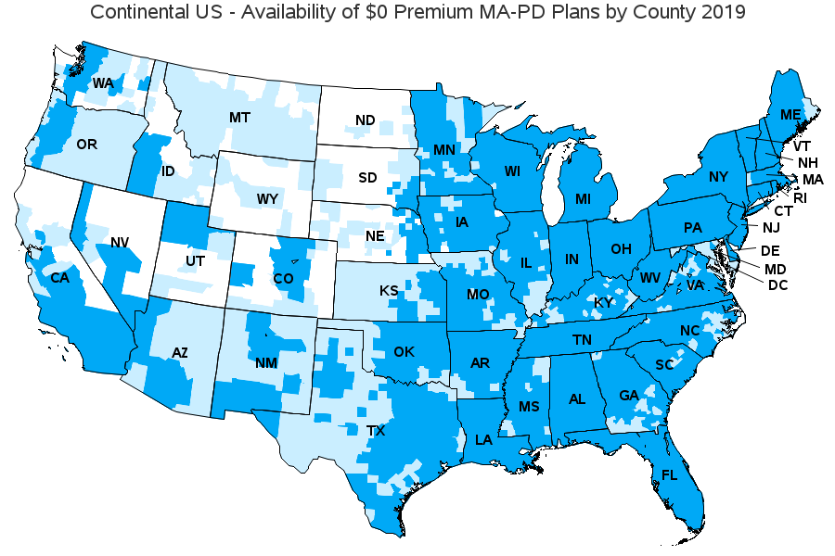


Availability of Medicare Advantage
Medicare Advantage-Prescription Drug (MA-PD) plans with a $0-premium are widely available where there are more plan options available.
AVAILABILITY OF $0-PREMIUM MA-PD PLANS BY COUNTY, 2019
AK
Available (2,212 counties)
HI
Not Available (655 counties)
No MA Plans in 2019 (276 counties)
Source: Avalere Health analysis using PlanScape®, a proprietary database of plan formularies and benefit designs and 2019 MA plan data released by CMS on September 28, 2018.

Slide 12
Payment in Medicare Advantage

Slide 13
Payment in MA
Payments to Medicare Advantage are established by plans’ bids relative to a county-level benchmark of average spending in FFS Medicare. If bid is below benchmark, plans keep portion to provide extra benefits (lower cost sharing, supplemental benefits).
PAYMENT EXAMPLE
(ILLUSTRATIVE)
Beneficiary premium for
Part A/B services= $100
CMS savings = $50
Benchmark = $1,000
Rebate amount = $50
Plans that receive 4 or 5 stars are eligible to receive a higher rebate percentage
= Plan bid
= Rebate to plan
= Beneficiary premium
Plan bid = $1,100
Plan payment from CMS = $1,000
Plan bid = $900
Plan payment from CMS = $950

Slide 14
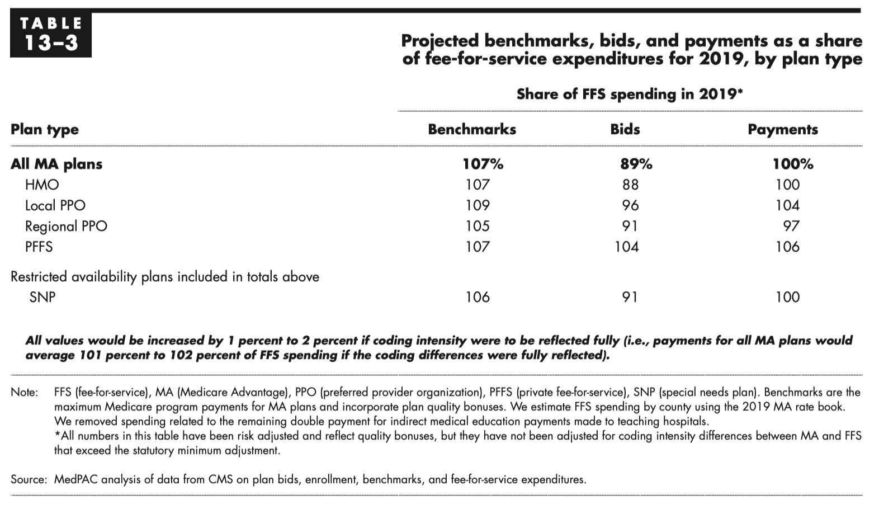
Payments to MA Compared to FFS

Slide 15
What Are Supplemental Benefits?
Supplemental benefits are items and services that are not covered by Original FFS Medicare but may be offered by MA plans. They must meet 3 specific criteria.
Supplemental benefits are defined as those that are:
Not covered by Original Medicare
Primarily health-related
Plan must incur non-zero direct medical cost
Common supplemental benefits include:
Dental coverage
Hearing coverage
Vision services
Social work lines
Wellness programs
Fitness benefits

Slide 16





Plan Experimentation with New Supplemental Benefits in 2019
MOST PREVALENT "NEW" SUPPLEMENTAL BENEFITS OFFERED
Social Worker Line
Personal Home Care
Support for Caregivers
MOST PREVALENT PREVENTIVE SUPPLEMENTAL BENEFITS OFFERED
Remote Access Technologies*
Fitness Benefit
Health Education
16

Slide 17

Expansion of Supplemental Benefits in 2020 & Beyond
The Bipartisan Budget Act (BBA) of 2018 eliminated the “primarily health-related” standard for supplemental benefits for individuals with chronic conditions, effectively establishing a new category of benefits, beginning in 2020.
Special Supplemental Benefits for the Chronically Ill (SSBCI)
May include
Non-medical transportation
Home-delivered meals
Food and produce
Home safety modifications
Pest control
BBA specifies that MA plans may offer supplemental benefits that are not primarily-health related
Benefit must have a “reasonable expectation of improving or maintaining health or overall function”
Plans can target enrollees based on chronic condition and other factors, such as social determinants of health

Slide 18
Quality Measurement and Oversight in Medicare Advantage

Slide 19
Quality Measurement and Oversight in MA
Star Ratings measure an MA plan’s quality of health management and outcomes
Ratings range from 1-star (poorest quality) to 5-stars (highest quality), based on how plans perform on average across Part C and D measures related to 9 topic areas
Current ratings are based on 48 individual measures ranging from clinical performance to customer service
Plans are rated at the contract level, not the individual plan or county level
Star Ratings
Member Experience
Member Complaints
Customer Service
Drug Plan Customer Services
Drug Plan Member Complaints and Audit Findings
Drug Pricing and Patient Safety
Managing Chronic Conditions
Staying Healthy
Member Experience with Drug Plan
Part C
Measures
Part D
Measures

Slide 20

Quality Measurement and Oversight in MA
Beneficiary Choice
Quality Incentives
Compliance Tool
The Star Ratings System was originally created to help Medicare beneficiaries and their caregivers shop for the best plan option
High and low performing plans are indicated via Medicare Plan Finder
Beneficiaries have special election periods to select 5-star plans
The Affordable Care Act (ACA) linked star ratings to MA plan payment
Plans with ratings of at least 4 stars receive bonus payments that can be used to offer more benefits to enrollees at no extra cost
Plan rebate payments are tied to star rating level:
5 stars – 70% rebate
4 stars – 65% rebate
3 stars or less – 50% rebate
CMS terminates plan contracts with consistently less than 3 stars
Low-rated plans are prohibited from enrolling via Medicare Plan Finder
Members in plans with fewer than 3 stars have a special enrollment period

Slide 21
Other Areas of Oversight in Medicare Advantage
Provider networks and network adequacy
Risk adjustment data validation audits
Bid review and approval of benefits and cost-sharing
Encounter data
Appeals and grievances
Marketing and communications to beneficiaries
21

Slide 22
For more information: visit bettermedicarealliance.org

