Slide 1
Better Medicare Alliance
Medicare advantage- Polling Presentation
October 1, 2018

Slide 2
Bma Polling Presentation
Many seniors are not aware of the Medicare options available to them.
Among seniors on Traditional Medicare:
55% are unfamiliar with the Medicare Advantage option
Two in 4 did not know about the option of Medicare Advantage at first enrollment.
Key Points
Education is needed to inform seniors of the differences between their Medicare options.
Among seniors on Traditional Medicare, half (49%) do not understand the difference between Traditional Medicare and Medicare Advantage.
Seniors are not using the current tools available to them to learn more about the Medicare plan:
2% use Medicare Plan Finder tool
3% use the 1-800-Medicare phone number
5% use Medicare counselors
22% use medicare.gov
24% use the Medicare & You Handbook
Methodology
This poll was conducted between September 18-September 22, 2018 among a national sample of 2001 Seniors on Medicare. The interviews were conducted online. Results from the full survey have a margin of error of plus or minus 2 percentage points.

Slide 3
Bma Polling Presentation
Awareness and evaluation of Medicare Advantage
Content
Medicare resources utilized

Slide 4
A majority (55%) of seniors on Traditional Medicare are unfamiliar with Medicare Advantage plans.
Bma Polling Presentation
How familiar are you with Medicare Advantage plans, generally?
Familiar
Awareness and evaluation of Medicare Advantage
42%
68%
84%

Slide 5
Among seniors on Traditional Medicare, half (49%) do not understand the difference between Medicare Advantage and Traditional Medicare.
Bma Polling Presentation
Do you agree or disagree with the following statement? I understand the difference between Medicare Advantage and Traditional Medicare.
Agree
Awareness and evaluation of Medicare Advantage
52%
72%
85%

Slide 6
However, 2 in 3 seniors on Traditional Medicare say they did not know about the option of Medicare Advantage at first enrollment.
Bma Polling Presentation
Did you know about the option Medicare Advantage at first enrollment?
Awareness and evaluation of Medicare Advantage

Slide 7
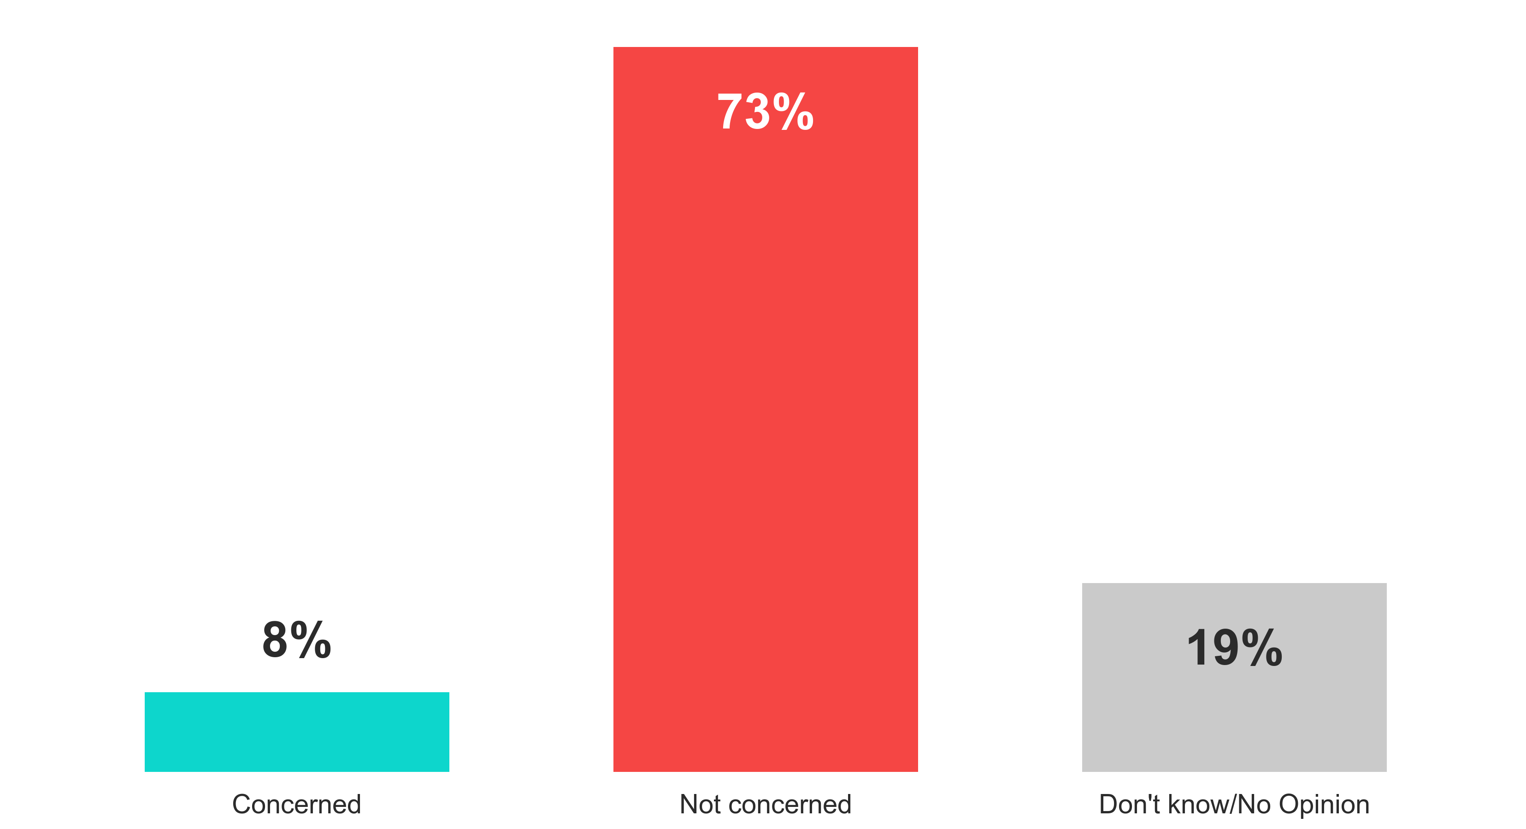
Respondents have little concern about being able to switch back to Traditional Medicare.
BMA12
Bma Polling Presentation
Are you concerned or not concerned about being able to switch back to Traditional Medicare?
Awareness and evaluation of Medicare Advantage

Slide 8
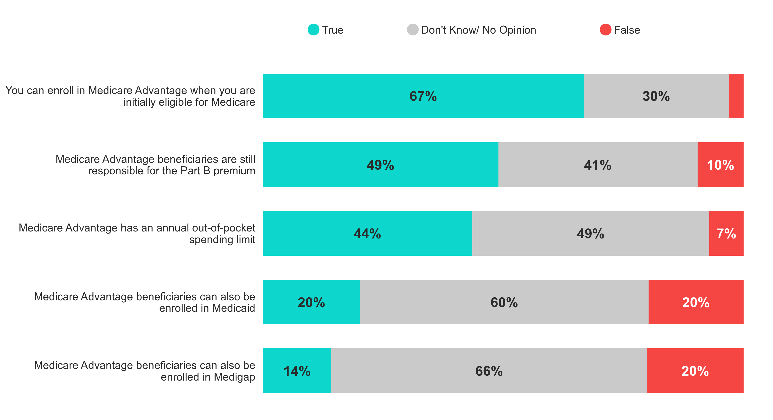
A majority (56%) of seniors don’t know that Medicare Advantage has out-of-pocket spending limits.
BMA24
Bma Polling Presentation
Are the following statements true or false?
Change in ‘True’ from Dec. 2017
-2%
-4%
-4%
+4%
+2%
Awareness and evaluation of Medicare Advantage

Slide 9
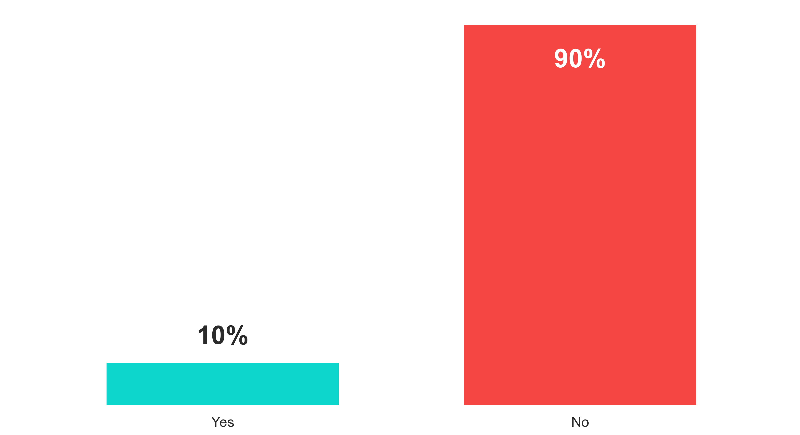
There is a lack of awareness of Medicare Advantage Special Needs Plans.
BMA27
Bma Polling Presentation
Have you ever heard of Medicare Advantage Special Needs Plans (SNPs)?
Awareness and evaluation of Medicare Advantage
Change from Dec. 2017 | 0% | 0%

Slide 10
Bma Polling Presentation
Awareness and evaluation of Medicare Advantage
Content
Medicare resources utilized

Slide 11
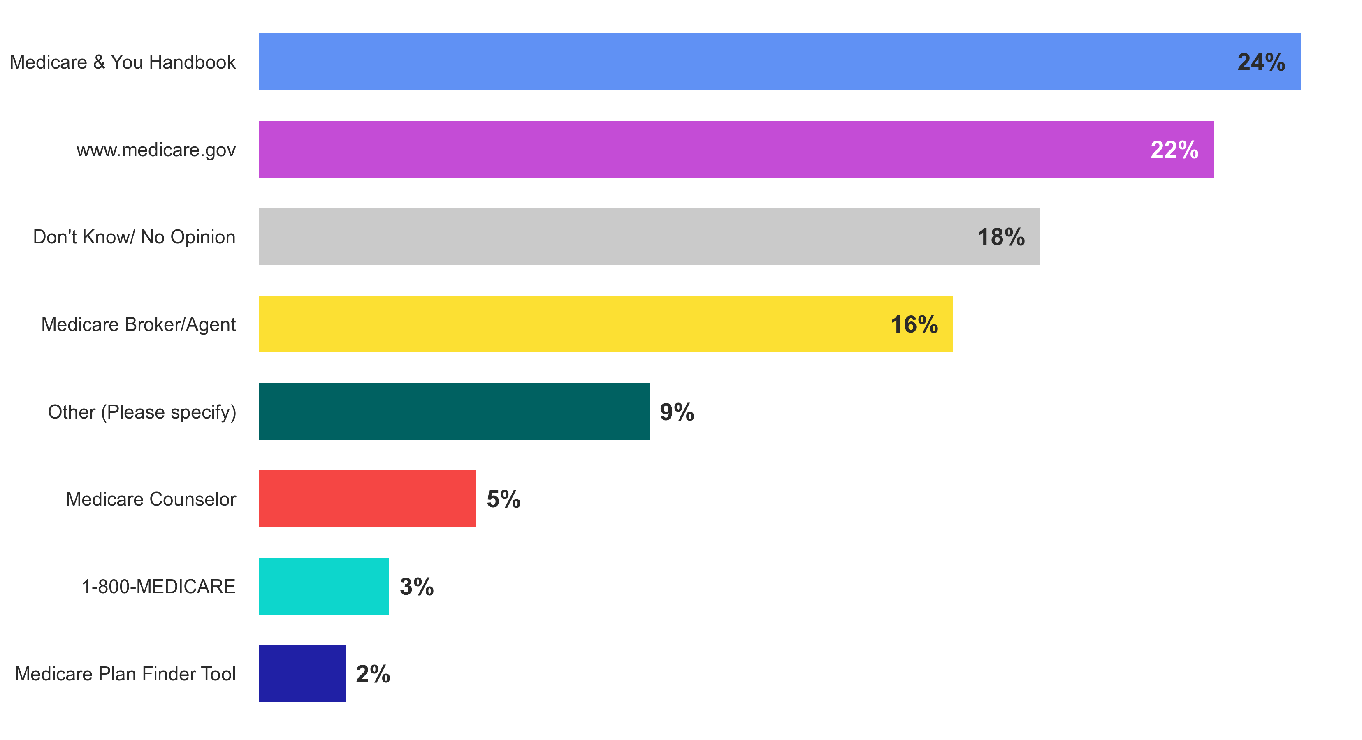
Respondents use a variety of resources to research Medicare enrollment options, but a plurality mainly rely on the Medicare & You Handbook.
BMA7
Bma Polling Presentation
What is the main resource you use to research your Medicare enrollment options?
Change from Dec. 2017
0%
-2%
-3%
N/A
-4%
-6%
0%
-1%
Medicare resources utilized

Slide 12
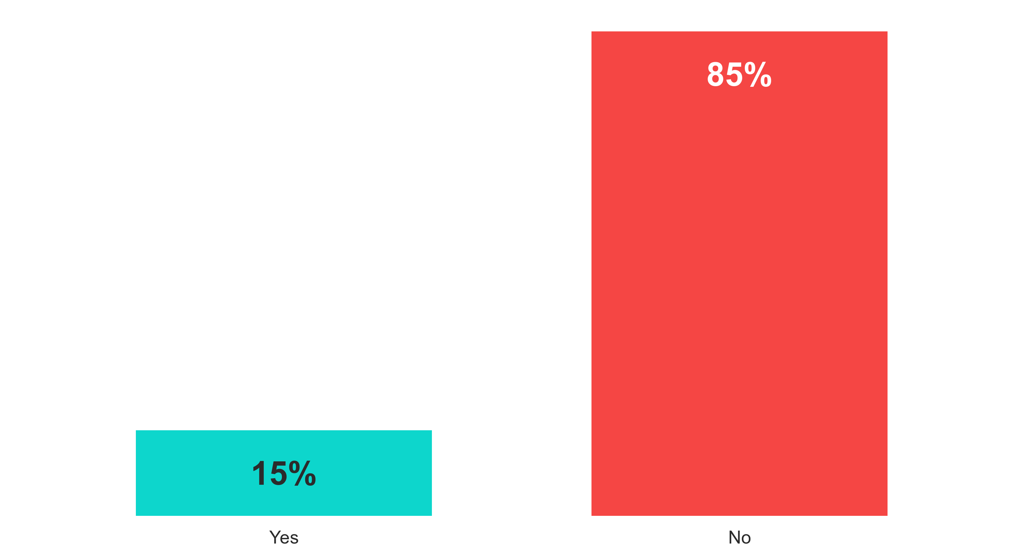
15% have used the Medicare Plan Finder Tool in the past year, a slight decrease from 2017.
BMA42
Bma Polling Presentation
Have you ever used the Medicare Plan Finder Tool (an online tool available through Medicare.gov) to learn more about the Medicare Advantage plans in your area?
Medicare resources utilized
Change from Dec. 2017 | -4% | +4%

Slide 13
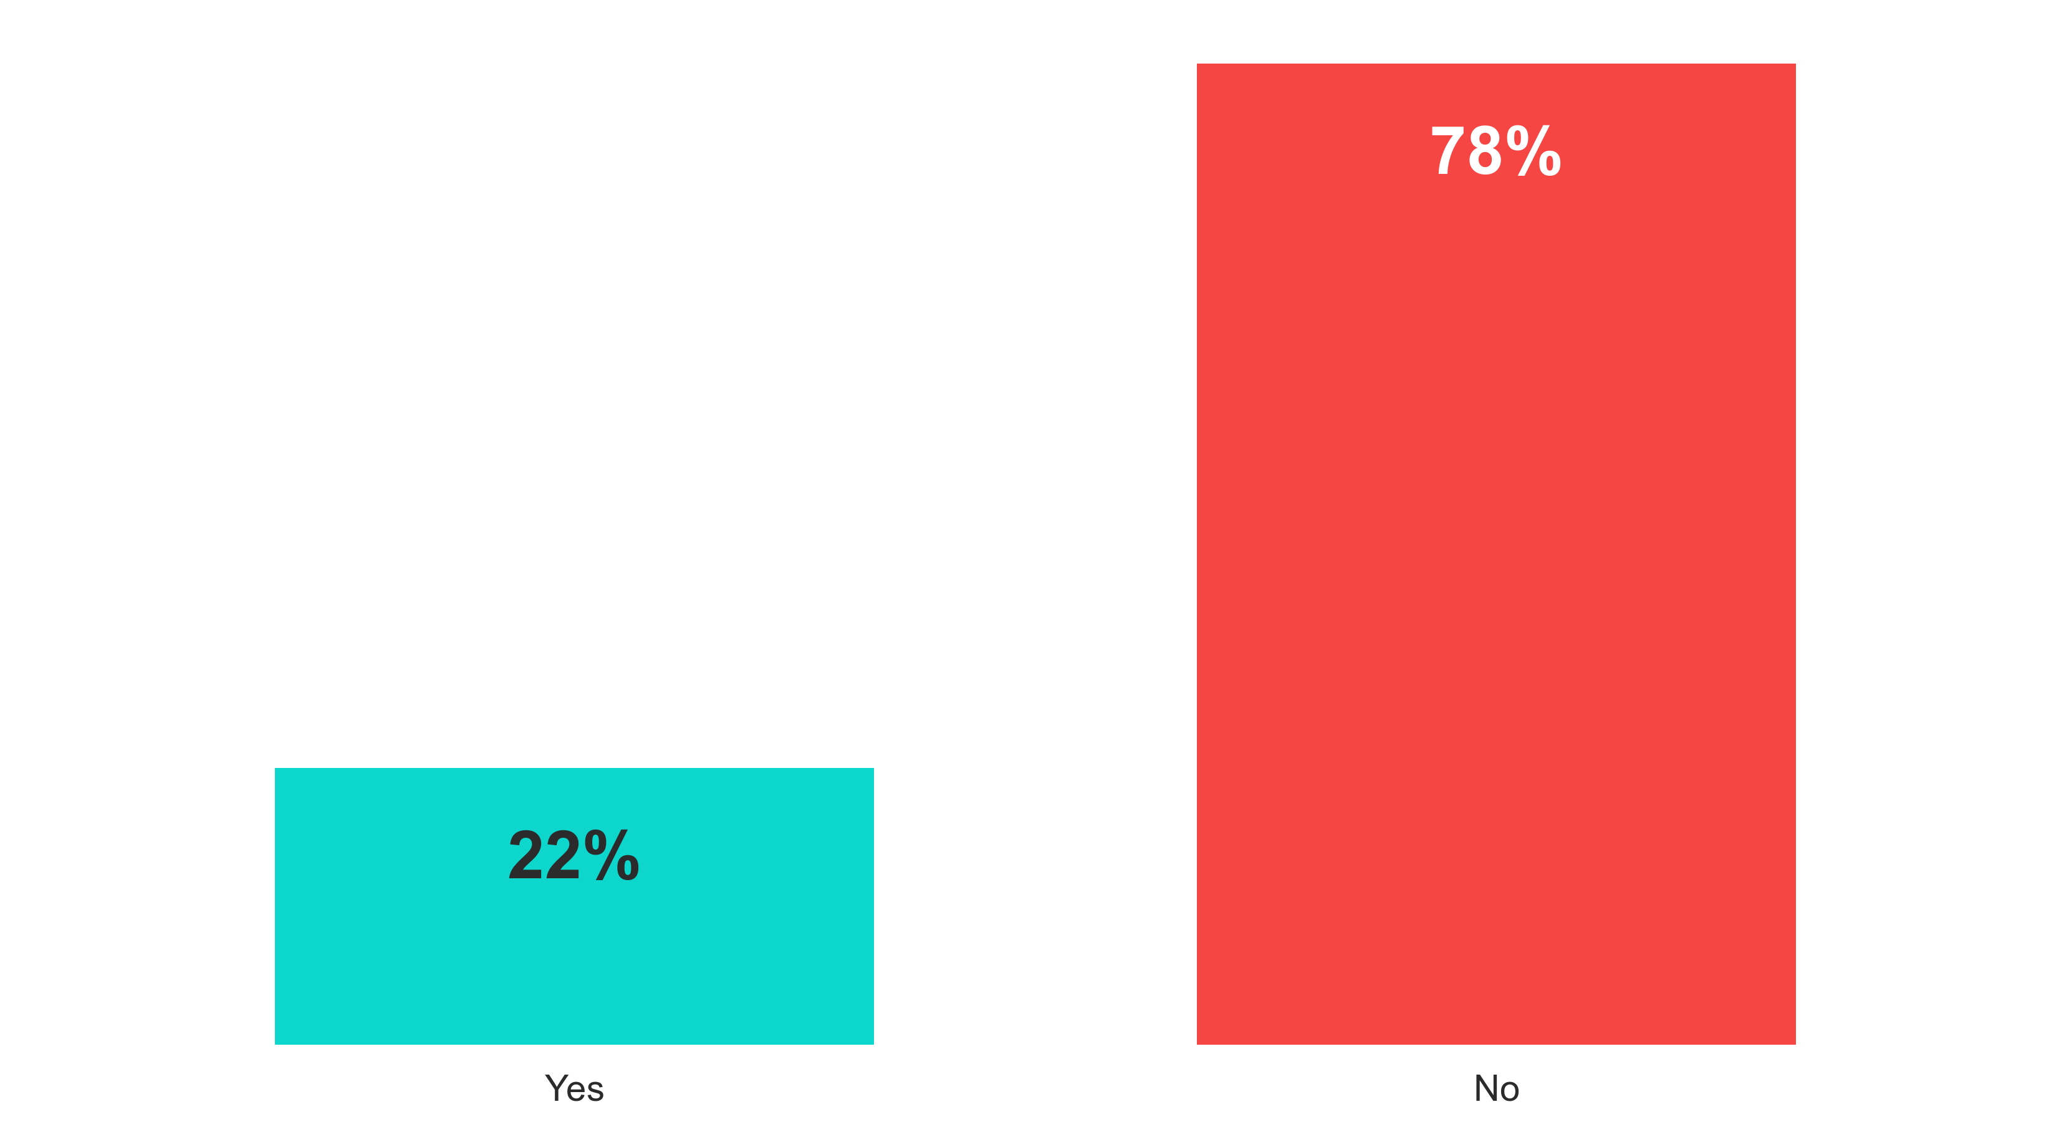
One in 5 have called 1-800-Medicare to ask questions about coverage options.
BMA40
Bma Polling Presentation
Have you ever called 1-800-Medicare to ask questions about your coverage options?
Medicare resources utilized
Change from Dec. 2017 | +1% | -1%

